Slide 2

Sass (stylesheet language)
By : Farbod Behnaminia
https://github.com/farbodDreamliner

Slide 3
Sass (Syntactically Awesome Stylesheets)
is a style sheet language .
Website : http://www.sass-lang.com/
یک زبان برنامه نویسی که به CSS تفسیر می شود .
consists of two syntaxes :
original syntax (SASS)(the indented syntax) : استفاده از دندانه برای جدا کردن بلاک های کدها و خط جدید برای جدا کردن قواعد (rules)
SCSS : uses block formatting like that of CSS ( syntax like what we have in C programming ) . It uses braces to denote code blocks and semicolons to separate lines within a block .
Leads to extensions .sass and .scss

Slide 4
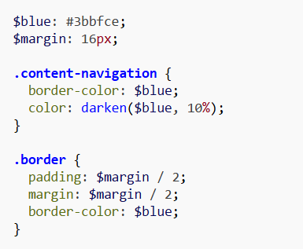
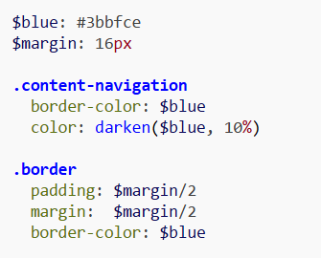
Syntaxes
SCSS style :
SASS style :

Slide 5
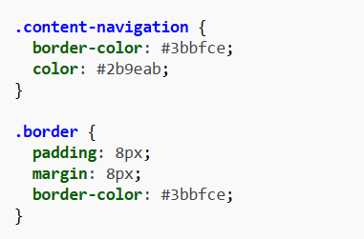
وقتی کهSassScript تفسیر می شود بلوک هایی از قواعدCSS می سازد .

Slide 6
SassScript mechanisms
Variables
Nesting
Mixins
Selector inheritance

Slide 7
SassScript mechanisms ( Variables )
تعریف متغیرها با علامت دلار ( $ ) شروع می شود و مقدار دهی با دونقطه ( : ) صورت می گیرد .
چهار عدد نوع داده ای را پشتیبانی می کند :
اعداد
رشته ها
رنگ ها
متغیر های بولی ( Booleans )
متغیرها می توانند آرگومان ها یا نتیجه ی یک یا چند تابع باشند . در هنگام تفسیر (کامپایل) مقدار متغیرها در خروجی فایل CSS قرار می گیرد .
$blue: #3bbfce; $blue: #3bbfce
$margin: 16px; $margin: 16px

Slide 8
$blue: #3bbfce;
$margin: 16px;
.content-navigation {
border-color: $blue;
color: darken($blue, 10%);
}
.border {
padding: $margin / 2;
margin: $margin / 2;
border-color: $blue;
}
$blue: #3bbfce
$margin: 16px
.content-navigation
border-color:
$blue color: darken($blue, 10%)
.border
padding: $margin/2
margin: $margin/2
border-color: $blue

Slide 9
Would compile to:
.content-navigation {
border-color: #3bbfce;
color: #2b9eab;
}
.border {
padding: 8px;
margin: 8px;
border-color: #3bbfce;
}

Slide 10
SassScript mechanisms (Nesting )
CSS تودرتویی را پشتیبانی می کند اما خود بلوک های کد نمی توانند درون یکدیگر باشند . Sass اجازه می دهد که کد ها در یکدیگر وارد شوند .
table.hl {
margin: 2em 0;
td.ln {
text-align: right;
}
}
li {
font: {
family: serif;
weight: bold;
size: 1.3em;
}
}
Would compile to:
table.hl {
margin: 2em 0;
}
table.hl td.ln {
text-align: right;
}
li {
font-family: serif;
font-weight: bold;
font-size: 1.3em;
}

Slide 11
SassScript mechanisms (Mixins)
CSS does not support mixins. Any repeated code must be repeated in each location. A mixin is a section of code that contains any valid Sass code. Mixins allow for efficient and clean code repetitions, as well as easy alteration of code.
@mixin table-base {
th {
text-align: center; font-weight: bold;
}
td, th {padding: 2px}
}
#data {
@include table-base;
}
Would compile to:
#data th {
text-align: center;
font-weight: bold;
}
#data td, #data th {
padding: 2px;
}

Slide 12
Sass allows for iterating over variables using @for, @each and @while, which can be used to apply different styles to elements with similar classes or ids.
#square-1 {
background-color: red;
width: 50px;
height: 120px;
}
#square-2 {
background-color: red;
width: 100px;
height: 60px;
}
#square-3 {
background-color: red;
width: 150px;
height: 40px;
}
$squareCount: 3;
@for $i from 1 through $squareCount { #square-#{$i} {
background-color: red;
width: 50px * $i;
height: 120px / $i;
}
}
Would compile to:

Slide 13
Mixins also support arguments.
@mixin left($dist) {
float: left;
margin-left: $dist;
}
#data {
@include left(10px);
}
Would compile to:
#data {
float: left;
margin-left: 10px;
}

Slide 14
@mixin table-base {
th {
text-align: center; font-weight: bold;
}
td, th {padding: 2px}
}
@mixin left($dist) {
float: left;
margin-left: $dist;
}
#data {
@include left(10px);
@include table-base;
}
Would compile to:
#data {
float: left;
margin-left: 10px;
}
#data th {
text-align: center;
font-weight: bold;
}
#data td, #data th {
padding: 2px;
}

Slide 15
SassScript mechanisms (Selector inheritance)
In Sass, inheritance is achieved by inserting a line inside of a code block that uses the @extend keyword and references another selector. The extended selector's attributes are applied to the calling selector. Sass supports multiple inheritance too.
Would compile to:
.error, .badError {
border: 1px #f00;
background: #fdd;
}
.error.intrusion, .badError.intrusion {
font-size: 1.3em;
font-weight: bold;
}
.badError {
border-width: 3px;
}
.error {
border: 1px #f00;
background: #fdd;
}
.error.intrusion {
font-size: 1.3em;
font-weight: bold;
}
.badError {
@extend .error;
border-width: 3px;
}

Slide 16
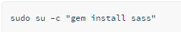
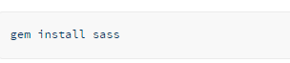
How to install Sass (Linux )
The official implementation of Sass is open-source and coded in Ruby; if you're using a distribution of Linux, you'll need to install Ruby first.
Install Sass
Open your Terminal
Install Sass. Ruby uses Gems to manage its various packages of code like Sass. In your open terminal window type:
https://www.digitalocean.com/community/tutorials/how-to-set-up-sass-on-your-vps-running-on-ubuntu

Slide 17
Go and play …

